Slide 1










Software Technologies
Course Overview
Software Technologies
SoftUni Team
Technical Trainers
Software University
http://softuni.bg

Slide 2

Table of Contents
Course Objectives
Course Program
Trainers Team
Course Schedule
Exams and Evaluation
Learning Resources

Slide 3
Have a Question?
sli.do #Tech

Slide 4



Software Technologies
Software Technologies
Course Objectives & Program

Slide 5
Course Objectives
The Software Technologies course provides the first steps in 4 technologies:
Web development with PHP
Web development with JavaScript
Web development with C#
Web development with Java

Slide 6
Warning: This Course is at Very Basic Level
The course is very introductory
It will NOT teach you in HTML, CSS, JavaScript, PHP, MySQL, .NET, SQL Server, Entity Framework, ASP.NET MVC, Java, Hibernate and Spring MVC
It will make you familiar with these technologies
You get an idea how these technologies work
You will touch all of them in 3 months
You will create a simple blog system

Slide 7
Course Topics
Part I – PHP & MySQL
XAMPP, PHP 7, MySQL, Doctrine, Symfony
Creating a blog with Symfony and MySQL
Part II – JavaScript and MongoDB
ES6, Node.js, Express.js, MongoDB
Creating a blog with Express.js and MongoDB

Slide 8
Course Topics (2)
Part III – Java Web Development
Java 8, Hibernate and Spring MVC
Creating a blog with Spring MVC and Hibernate
Part IV – C# Web Development
C# 6, Entity Framework, ASP.NET MVC and SQL Server
Creating a blog with ASP.NET MVC and EF

Slide 9
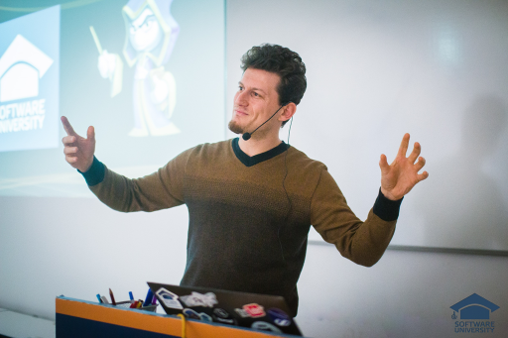
The Trainers Team

Slide 10
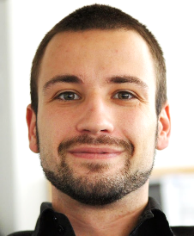
Trainers Team
Angel Georgiev
Training Director @ Software University (SoftUni)
10 years of experience as trainer
6 years of experience in sales and marketing
4+ years of programming experience

Slide 11
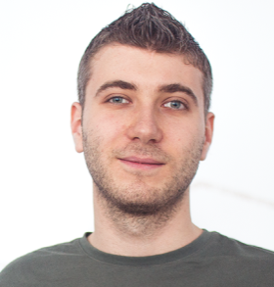
Trainers Team
Ivan Yonkov
Training Lead & Trainer @ SoftUni
5 years of programming experience mainly with Java and PHP
Solid experience as QA engineer
Top performing student from the Software University (2014)

Slide 12
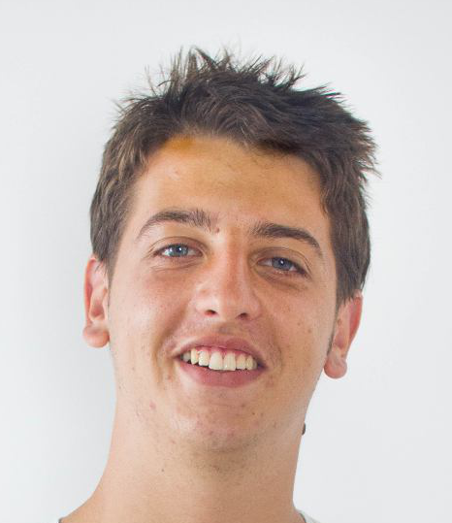
Trainers Team
Georgi Stoimenov
Technical Trainer @ Software University
Top performing student from the Software University

Slide 13
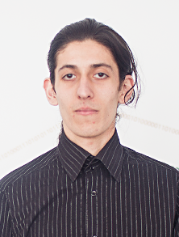
Trainers Team
Simeon Sheytanov
Technical Trainer @ Software University
Top performing student from the Software University
Programming experience with C#, Java, C++, Python, JavaScript, PHP, VB, Assembler and other programming languages
Interested in game development

Slide 14
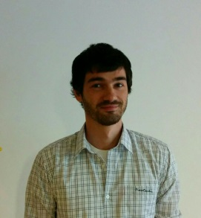
Trainers Team
Peter Penev
Technical Trainer @ Software University
Top performing student from the Software University
Deep interest in Data Structures & Algorithms

Slide 15
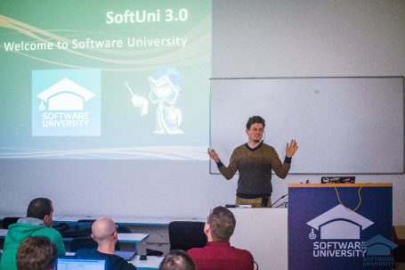


Software Technologies
Course Details and Schedule

Slide 16
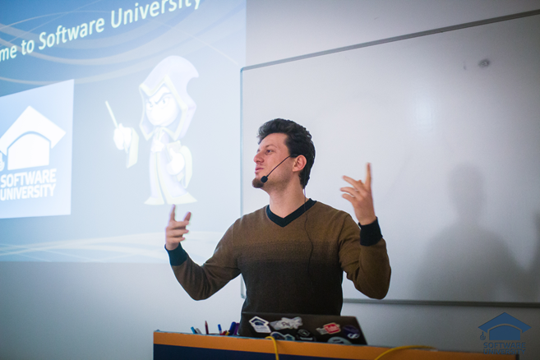
Training Duration and Schedule
Lessons: ~ 56 hours (onsite + YouTube videos)
Practical exercises (in class): ~ 112 hours
Project defense: 0.2 hours
Allocation
Timeframe: October – December 2016
Exam: 21-22 December 2016

Slide 17

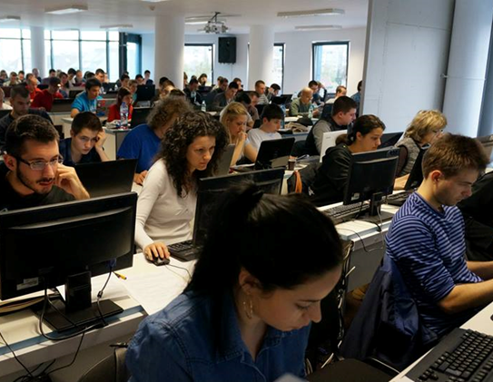
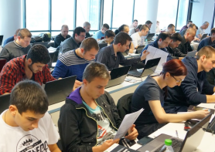
Software Technologies
Evaluation Criteria

Slide 18


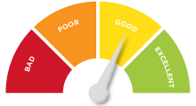
Scoring System for the Course
Practical project – 90%
Exercise submissions – 10%
Forum activity – bonus up to 10%
Presence in class – 5% bonus

Slide 19


Homework Assignments
Your homework is mainly work in class!
Lesson days → live workshop
Exercise days → only exercises
How to submit your homework?
Some submitted in the judge system
Others uploaded in the course Web site
Homework assignments are due in 1 week

Slide 20

Teamwork / Practical Project
Choose one of the technologies
JS, PHP, C# or Java
Build a team or work alone
Choose your teammates
Develop a practical project
Choose from existing projects
Or work on your own idea
Public defense → demonstrate your work live at SoftUni

Slide 21










Resources
What We Need Additionally?

Slide 22

Course Web Site & Forums
The Programming Basics official web site:
Register for the "Software University Forum":
Discuss the course exercises with your colleagues
Find solutions for all course exercises
Share source code / discuss ideas / help each other
https://softuni.bg/courses/software-technologies
https://softuni.bg/forum/categories/45

Slide 23

The Programming Basics Slides and Videos
All lecture slides, videos, homework assignments, projects and other resources are open content, available for free
Visit the course web site to access the course resources

Slide 24




Recommended Software
Software needed for this course:
WebStorm – https://jetbrains.com/webstorm/ – for JS
PhpStorm – https://jetbrains.com/phpstorm/ – for PHP
Visual Studio – https://www.visualstudio.com – for .NET
IntelliJ Idea – https://www.jetbrains.com/idea/ – for Java

Slide 25









Software Technologies – Course Intro
https://softuni.bg/courses/software-technologies

Slide 26
License
This course (slides, examples, demos, videos, homework, etc.) is licensed under the "Creative Commons Attribution-NonCommercial-ShareAlike 4.0 International" license

Slide 27






Free Trainings @ Software University
Software University Foundation – softuni.org
Software University – High-Quality Education, Profession and Job for Software Developers
softuni.bg
Software University @ Facebook
facebook.com/SoftwareUniversity
Software University @ YouTube
youtube.com/SoftwareUniversity
Software University Forums – forum.softuni.bg

